Slide 1
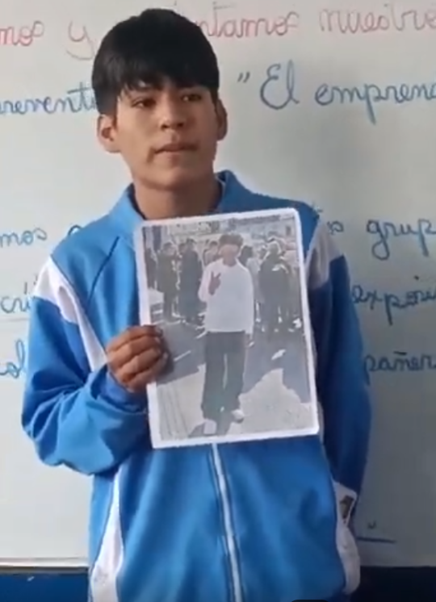
https://drive.google.com/drive/folders/1S5Gz91EEmqpNHvEeGxWd56o_s-3j6XW6?usp=drive_link

